Slide 1
Spring 2022: The First Row;
<<Sorting Algorithms;
( 5 1 4 2 8 ) –> ( 1 5 4 2 8 )
( 1 2 4 5 8 ) –> ( 1 2 4 5 8 )
<< BY:
John Rempe; Trent Menard; Hassan Khan;

Slide 2
The Interface: GenAlgs
Module Introduction
Modules were introduced in C++20. They essentially replace header files for easier API creation. They also speed up compilation time by not having to copy the header files into the .cpp every time. The primary interface, GenAlgs, is defined within a module.
See: https://docs.microsoft.com/en-us/cpp/cpp/modules-cpp?view=msvc-170 for more information.

Slide 3
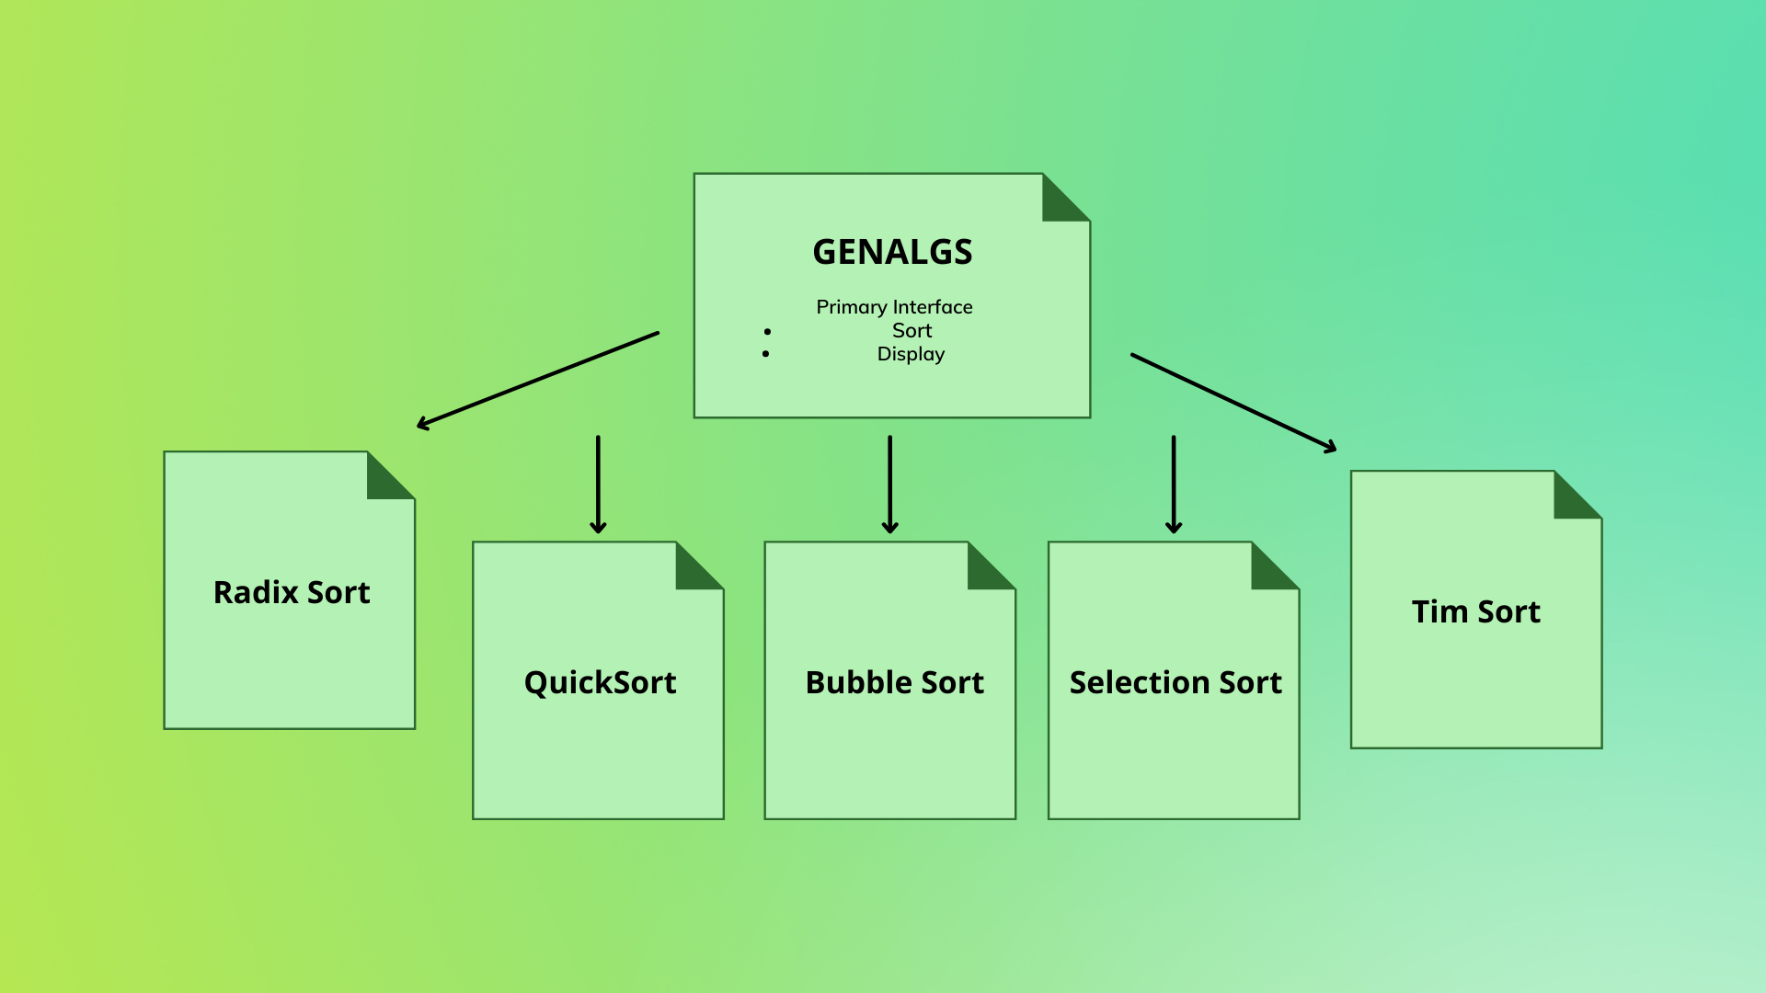
The Interface: GenAlgs

Slide 4
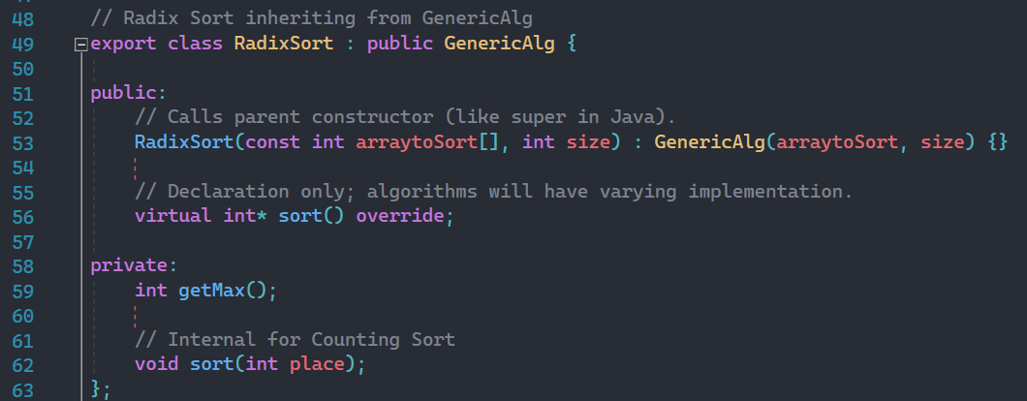
GenAlgs Interface: Radix Example

Slide 5
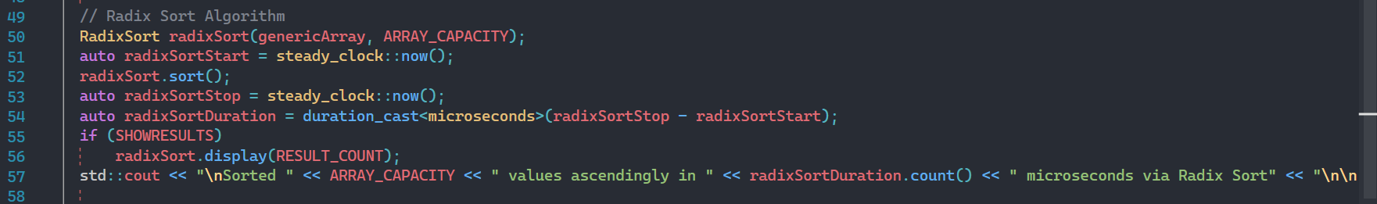
GenAlgs Interface: Radix Example

Slide 6
The Interface: GenAlgs
Module Introduction
Modules were introduced in C++20. They essentially replace header files for easier API creation. They also speed up compilation time by not having to copy the header files into the .cpp every time. The primary interface, GenAlgs, is defined within a module.
See: https://docs.microsoft.com/en-us/cpp/cpp/modules-cpp?view=msvc-170 for more information.

Slide 7
O (n log n)- Quick Sort
0 | 1 | 2 | 3 | 4 | 5 | 6 | 7
14 (pivot) | 23 (up) | 17 | 0 | 25 | 9 | 32 | 13 (down)
14 (pivot) | 13 | 17 (up) | 0 | 25 | 9 (down) | 32 | 23
14 (pivot) | 13 | 9 | 0 (down) | 25 (up) | 17 | 32 | 23
0 (pivot) | 13 | 9 | 14 | 25 | 17 | 32 | 23
0 | 13 (pivot) | 9 (down) | 14 | 25 (up) | 17 | 32 | 23
0 | 9 | 13 | 14 | 25 (pivot) | 17 (down) | 32 (up) | 23
0 | 9 | 13 | 14 | 17 | 25 (pivot) | 32 (up) | 23 (down)
0 | 9 | 13 | 14 | 17 | 25 (pivot) | 23 (down) | 32 (up)
0 | 9 | 13 | 14 | 17 | 23 | 25 | 32

Slide 8
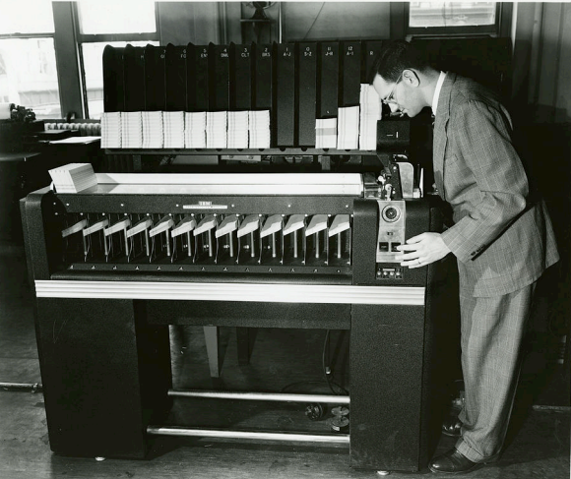
O (n log n)- Radix Sort (continued)
Radix was used back in the day on an IBM card sorter
Cards like these were used with grids on the with holes punched in them do store the data

Slide 9
O (n log n)- Radix Sort
Initial list: 314, 133, 427, 110, 235, 219, 142, 403
One’s place: 110, 142, 133, 403, 314, 235, 427, 219
Ten’s place: 403, 110, 314, 219, 427, 133, 235, 142
Hundreds place: 110, 133, 142, 219, 235, 314, 403, 427

Slide 10
O(n²)
Bubble Sort
Selection Sort
38,47,5,44,3
3, 47, 5, 44, 38
3, 47, 5, 44, 38
3, 5, 47, 44, 38
3, 5, 47, 44, 38
3, 5, 38, 44, 47
3, 5, 38, 44, 47
Sorted: 3, 5, 38, 44, 47
38,47,5,44,3
First pass:
38, 47, 5, 44, 3
38, 5, 47, 44, 3
38, 5, 44, 47, 3
38, 5, 44, 3, 47
Third pass:
5, 3, 38, 44, 47 (sorted)
Second pass:
5, 38, 44, 3, 47
5, 38, 44, 3, 47
5, 38, 3, 44, 47
5, 38, 3, 44, 47

Slide 11

New Algorithm: Timsort
Created by Tim Peters for Python in 2001.
Since its creation, it has now been adapted as the default sorting algorithm for Python, Java, the Android Platform, and in GNU Octave
Combination of Insertion Sort & Merge Sort depending on the input
If 64 of fewer elements, run Insertion Sort
If over 64 elements, divide into RUN chunks, reverse chunks using Insertion Sort, combine chunks using Merge Sort
Merge performs well when the subarrays sizes are powers of 2 ; based on the fact that Insertion Sort performs well for small arrays.
https://skerritt.blog/timsort/

Slide 12
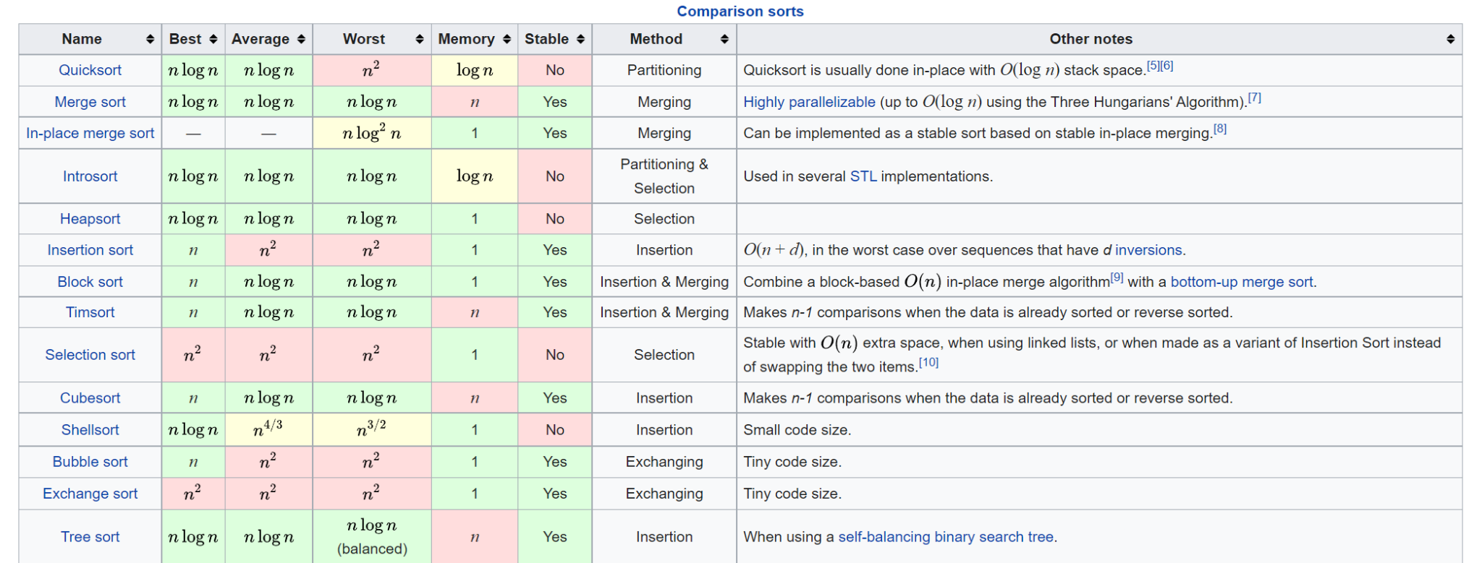
General Sort Comparisons
https://en.wikipedia.org/wiki/Sorting_algorithm

Slide 13
General Sort Comparisons
https://www.enjoyalgorithms.com/blog/comparison-of-sorting-algorithms

Slide 14
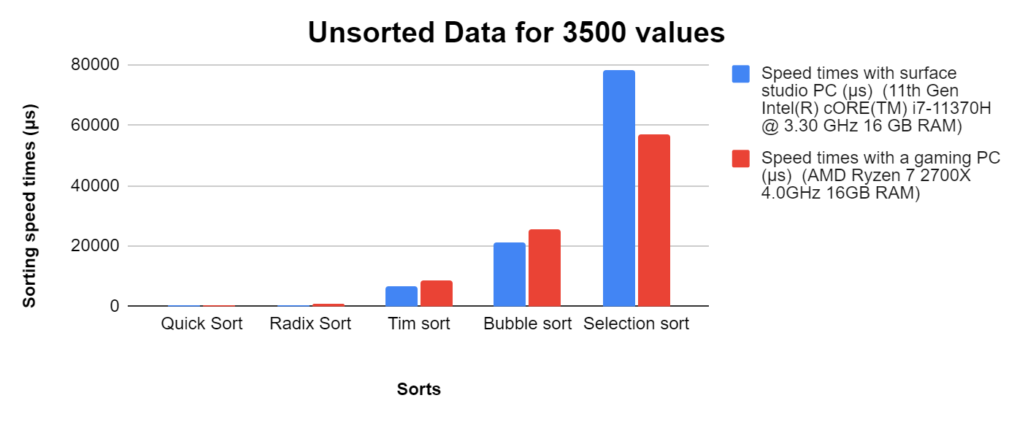
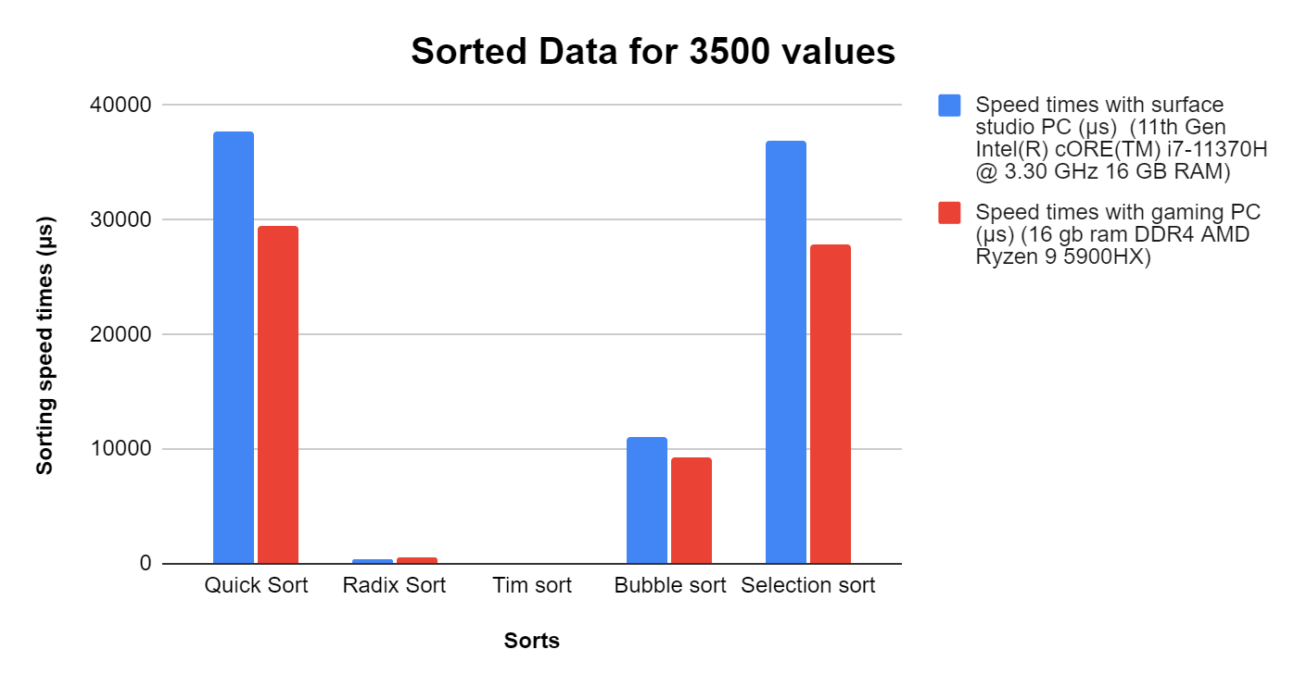
Sorted data VS Unsorted data
“A challenge faced was with sorted data that had capped at 3500 values, we use the speed data for 3500 values for unsorted data as well for even comparison.”

Slide 15
Thank You!

